Slide 1


Introduction to AJAX
Asynchronous development
SUPINFO Official Document
Notes:
© SUPINFO International University - http://www.supinfo.com
SUPINFO vous permet de partager ce document
Vous êtes libre de :
Partager — reproduire, distribuer et communiquer ce document Remixer — modifier ce document
A condition de respecter les règles suivantes :
Indication obligatoire de la paternité — Vous devez obligatoirement préciser l’origine « SUPINFO » du document au début de celui-ci de la même manière qu’indiqué par SUPINFO International University – Notamment en laissant obligatoirement la première et la dernière page du document, mais pas d'une manière qui suggérerait que SUPINFO International University vous soutiennent ou approuvent votre utilisation du document, surtout si vous le modifiez. Dans ce dernier cas, il vous faudra obligatoirement supprimer le texte « SUPINFO Official Document » en tête de page et préciser notamment la page indiquant votre identité et les modifications principales apportées.
En dehors de ces dispositions, aucune autre modification de la première et de la dernière page du document n’est autorisée.
NOTE IMPORTANTE : Ce document est mis à disposition selon le contrat CC-BY-NC-SA Creative Commons disponible en ligne http://creativecommons.org/licenses ou par courrier postal à Creative Commons, 171 Second Street, Suite 300, San Francisco, California 94105, USA modifié en ce sens que la première et la dernière page du document ne peuvent être supprimées en cas de reproduction, distribution, communication ou modification. Vous pouvez donc reproduire, remixer, arranger et adapter ce document à des fins non commerciales tant que vous respectez les règles de paternité et que les nouveaux documents sont protégés selon des termes identiques. Les autorisations au-delà du champ de cette licence peuvent être obtenues à support@supinfo.com.
© SUPINFO International University – EDUCINVEST - Rue Ducale, 29 - 1000 Brussels Belgium . www.supinfo.com

Slide 2

Course objectives
Introduction to AJAX
By completing this course you will be able to:
Define what is AJAX
Use AJAX for better User Experience (UX)

Slide 3

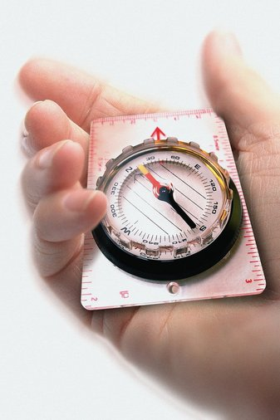
Course plan
Introduction to AJAX
What is AJAX?
XmlHttpRequest
AJAX with jQuery

Slide 4

What is AJAX?
Introduction to AJAX

Slide 5

Simply Explained
What is AJAX?
ASYNCHRONOUS
JAVASCRIPT
AND
XML

Slide 6
Presentation
What is AJAX?
Neither a new language nor technology
It’s a development method
Client-side method to create interactive Web Apps
Retrieve data without interfering with page display
Initially based on XML
Now more used with JSON, xHTML, etc
Notes:
XMLHttpRequest object allows data interactions using HTTP request (also GET, POST and HEAD. PUT and DELETE too but they don't work on every browsers). Is goal is to retrieve XML data and others markup language like (X)HTML. But now we can retrieve much data type (JSON, …).
This is a very famous object because it allow interactive websites creation. There is many utilizations, for example : auto-completion, auto-save, area reloading without frames.
But AJAX as a few disadvantages, for examples bookmarks, links, navigation history... In more, web referencing can't be made.

Slide 7

Synchronous schema
What is AJAX?
User Activity
Page reload
User Activity
Page reload
…
Client-side
Time
Process
Process
Server-side

Slide 8
Asynchronous schema
What is AJAX?
User Activity
User Activity
…
Request - Update
Request - Update
Client-side
Time
Process
Process
Server-side

Slide 9
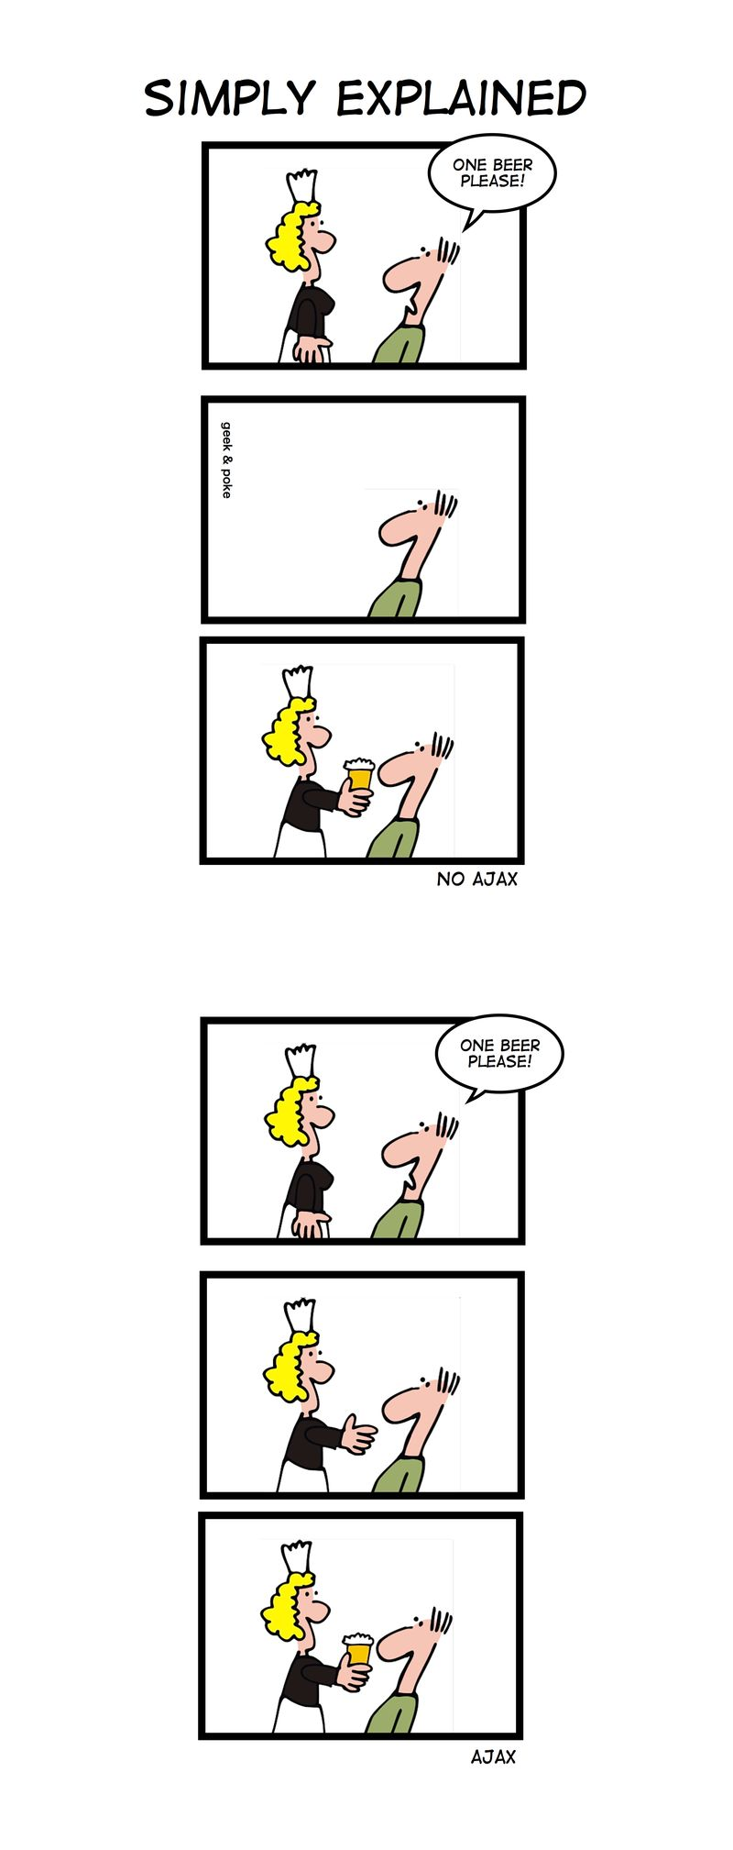
Geek & Poke© - AJAX

Slide 10
History
What is AJAX?
In the 90s, Web was based on complete HTML pages
Each user action required the page reload
Bad User Experience:
Time spent while page load
All content disappears then reappears
Excessive bandwidth used for servers

Slide 11
History
What is AJAX?
In 1995, Sun Microsystems introduced Java Applets
First enabling asynchronous loaded content
In 1996, Microsoft introduced the iframe element allowing asynchronous loaded content as well
In 1999, Microsoft created the XMLHTTP ActiveX component

Slide 12
History
What is AJAX?
Browser implementations:
Mozilla (2002), Safari (2004), Konqueror and Opera 8.0 (2005)
The “Ajax” term was coined in 2005 by Jesse James Garrett in an article entitled:
“Ajax: A new approach for Web Applications”
In 2006 the W3C released the first draft for the XmlHttpRequest object

Slide 13
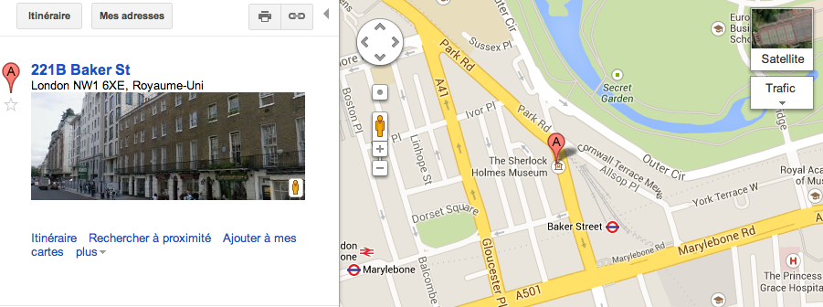
AJAX usage
What is AJAX?
Autocompletion for input field
Instant auto-save
Page part reloading
See Google Mail, Facebook, Outlook Web Access…

Slide 14
Disadvantages
What is AJAX?
Basic web features problem:
Previous, Next, Bookmarks
Referencing problem!
Doesn’t work with JavaScript disabled
Resource expensive if misused

Slide 15


Questions?

Slide 16

XmlHttpRequest
Introduction to AJAX

Slide 17
Presentation
XmlHttpRequest
To use AJAX you need to use a XmlHttpRequest JavaScript object
Represent an AJAX request!
Works on all “modern” Web browsers
To use AJAX with Internet Explorer 6, use an ActiveX object. More on comments.
var xhr = new XMLHttpRequest();
Notes:
http://www.informit.com/articles/article.aspx?p=667416&seqNum=2

Slide 18
Methods
XmlHttpRequest
Three main methods:
void open(method, URL):
Initialize the object with the HTTP method to use (GET/POST) and the URL to contact
void setRequestHeader(header, value):
Set a header value to the request. Must be used after open(…) and before send(…) functions
void send(data):
Send the request with data as request body. Must be called after open(…) function

Slide 19
AJAX request cycle
XmlHttpRequest
new XHR
User’s View
xhr.open
Event (click,…)
xhr.send
Display result
Server process

Slide 20
First example
XmlHttpRequest
GET Request:
POST Request:
var xhr = getXMLHttpRequest();
xhr.open("GET", "myPage.php?param1=12&param2=plop");
xhr.send(null);
var xhr = getXMLHttpRequest();
xhr.open("POST", "myPage.php");
xhr.setRequestHeader("Content-Type",
"application/x-www-form-urlencoded");
xhr.send("myParam1=12&myParam2=plop");
Notes:
Be careful : You must define the Content-Type header for POST requests!

Slide 21
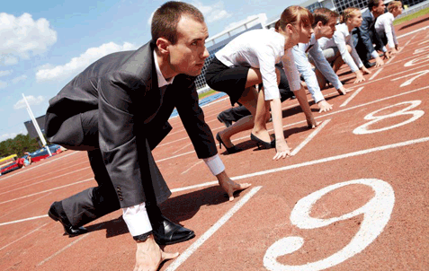
Ready State
XmlHttpRequest
Give information about request progress
Five possible values:
0: Uninitialized
1: Open (Send has not yet been called)
2: Send
3: Receiving
4: Finished (Success of Send)

Slide 22
Callback function
XmlHttpRequest
Process the response when needed
Ex: Refresh a portion of the page
As the request is asynchronous, the send function doesn’t return directly the response of the request
Override onreadystatechange event!

Slide 23
Callback function
XmlHttpRequest
Onreadystatechange event function:
Fired each time the readyState property is changed
var xhr = getXMLHttpRequest();
xhr.onreadystatechange = function() {
switch(xhr.readyState) {
case 0: alert("Initialized!"); break;
case 1: alert("Opened!"); break;
case 2: alert("Sent!"); break;
case 3: alert("Receiving!"); break;
case 4: alert("Finished!"); break;
}
};

Slide 24
Second example
XmlHttpRequest
var xhr = getXMLHttpRequest();
xhr.onreadystatechange = function() {
// If the request is finished
if(xhr.readyState == 4) {
// If the request return HTTP code 200 (Success)
if(xhr.status == 200) alert("Success!");
else alert("Error!");
}
};
xhr.open("GET", "myPage.php");
xhr.send(null);

Slide 25
Retrieve the response
XmlHttpRequest
AJAX is great but…
How to retrieve data from the server?
Imagin the following PHP code in myPage.php:
<?php
$username = $_GET['u'];
if($username == "test") echo "Success";
else echo "Error";
?>

Slide 26
Retrieve the response
XmlHttpRequest
To retrieve response from the server:
responseText: Text returned by server
responseXML: Object representing XML returned by server
status: Returns the HTTP code (remember? ☺)
statusText: Returns the status description

Slide 27
Famous HTTP status codes
XmlHttpRequest
HTTP Status Code | HTTP Status Text
200 | Success
201 | Created
301 | Permanently Redirected
302 | Found
400 | Bad Request
403 | Forbidden
404 | Not found
500 | Internal Server Error

Slide 28
Third example
XmlHttpRequest
var xhr = getXMLHttpRequest();
var flash = document.getElementById("div_flash");
xhr.onreadystatechange = function() {
if(xhr.readyState == 4) {
if(xhr.status == 200)
flash.innerHTML = (xhr.responseText);
else alert("Error!");
}
};
xhr.open("GET", "myPage.php");
xhr.send(null);
What will this code display?

Slide 29

Other methods…
XmlHttpRequest
HTTP Status Code | HTTP Status Text
abort() | Cancels the current request
getAllResponseHeaders() | Returns complete set of headers as a string
getResponseHeader("field") | Returns the value of the specified header

Slide 30
Questions?

Slide 31

Exercise (1/2)
Use AJAX with jQuery
Create a minimal page client.html in your project
Just the minimal structure, no content
Create a simple page remote.html
Some text inside a div called “content”
Put them in the same folder

Slide 32
Exercise (2/2)
Use AJAX with jQuery
Use AJAX to retrieve the remote.html page from client.html
If the request succeed:
Update the client.html page by inserting the remote code
If the request failed:
Display a message into your page to notice the user.
Your access URL must be localhost

Slide 33

Use ajax with jQuery
Introduction to AJAX

Slide 34
Presentation
Use AJAX with jQuery
jQuery has AJAX dedicated functions:
Almost only use of “ajax” function
$.ajax({
type: "POST",
url: "some.php",
data: "name=John&location=Boston",
success: function( msg ) {
alert( "Data Saved: " + msg );
}
});

Slide 35
Main Settings
Use AJAX with jQuery
url: Which URL to contact
method: GET or POST
async: True by default
False to make requests synchronous

Slide 36
Main Settings
Use AJAX with jQuery
contentType: Used when data is sent to the server
Default: application/x-www-form-urlencoded
data: Data to send to the server
Appended to URL if GET method
Converted to string if it’s not already a string

Slide 37
Main Settings
Use AJAX with jQuery
statusCode: Each HTTP status code can be associated with a dedicated function
$.ajax({
... ,
statusCode: {
404: function( ) {
alert( "Data Saved: " + msg );
}
}
});

Slide 38
Main Settings
Use AJAX with jQuery
error(jqXHR, textStatus, errorThrown):
Called if the request fails
success(data, textStatus, jqXHR):
Called if the request succeed
complete(jqXHR, textStatus):
Called when the request finishes (after success and error)

Slide 39
Questions?

Slide 40
Exercise
Use AJAX with jQuery
Create a new JavaScript file
Use jQuery to achieve the previous exercise goal
Check that it works!

Slide 41

The end
Introduction to AJAX
Thanks for your attention

